Slide 1
Substitution of Global Illumination by Virtual Point Lights for Interactive Cinematic Lighting
Author:
Dimitrios Kyteas
Advisor:
Georgios Papaioannou

Slide 2
Introduction I
Global Illumination (GI): General name of group of algorithms used to add more realistic lighting to 3D scenes.
Consists of direct and indirect illumination.
Direct illumination: Light that comes directly from light source
Indirect illumination: Light that is reflected/transmitted from other surfaces in the scene

Slide 3
Introduction II
Important effects
Diffuse inter-reflection (very important part of GI)
Specular (glossy) reflection (costly to simulate)
Algorithm examples : Radiosity, ray tracing, path tracing, photon mapping

Slide 4
The Rendering Equation
Expresses the balance of light distribution in a 3D scene
Considers:
photometric attributes of light sources
Material reflectivity (BRDF)
Integration domain S includes all y points of the scene surfaces.

Slide 5
Radiosity I
One of the first approaches to Global Illumination
Assumes all surfaces are diffuse reflectors
All light which is not absorbed by a surface is reflected onto other surfaces (conservation of energy)

Slide 6
Radiosity II
Algorithm overview
Surfaces are subdivided into smaller patches
A form factor for each pair of surfaces is computed. Represents the amount of light exchanged between them.
Form factors are used as coefficients in a discrete form of the rendering equation, which yields a linear system of equations. Solving this system yields the radiosity (brightness) of each patch.
High number of form factors makes the method suitable only for static scenes.

Slide 7
Instant Radiosity I [1]
Offers an approach using features of radiosity
Can be used for real-time rendering
Also assumes all surfaces are diffuse reflectors
Avoids form factors
Uses simple point lights

Slide 8
Instant Radiosity II
Overview:
Photons are traced from the light source into the scene
Each path vertex is treated as a Virtual Point Light (VPL)
The scene is rendered with shadows, once for each VPL
The final GI results from the accumulated results of the VPL-lit scene.

Slide 9
Instant Radiosity III
VPLs are computed on each frame
Allows dynamic lights
Allows dynamic geometry
Can be quite costly
The quality of the result depends on the number of VPLs
The algorithm is only used to create the indirect illumination

Slide 10
Instant Radiosity and the Rendering Equation
Integration domain M includes all the VPLs.
Since all surfaces are considered Lambertian:
The reflected radiance from a point x can be approximated by the following formula:

Slide 11
Instant Radiosity and Interactive Framerates
Rendering a shadowed image for each VPL is an expensive procedure
Usually at least 1000 VPLs are required for satisfactory results. This number is too much for an average PC.
Dachsbacher And Stamminger presented an interesting approach to Instant Radiosity in Reflective Shadow Maps [2]
Based on the idea that one-bounce indirect illumination is usually enough.

Slide 12
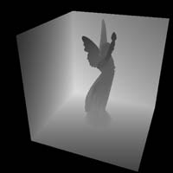
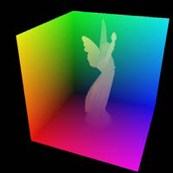
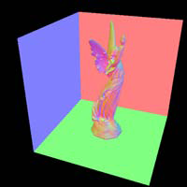
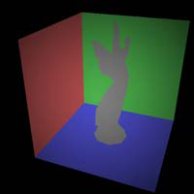
Reflective Shadow Maps I
Overview:
The scene is first rendered from the point of view of the light source and data is stored in a RSM
A RSM is an extended shadow map with multiple render targets
Except depth values, also contains world coordinates, normal vectors and reflected flux
Left to right: Depth, coordinates, normal and flux components of a RSM.

Slide 13
Reflective Shadow Maps II
Each RSM pixel, is treated as a VPL
To reduce VPL number (shadow maps are usually at least 512x512), the RSM is randomly sampled for each camera pixel
RSM offers spatial coherence
Calculation cost is still too high so an interpolation scheme is used (GI is first computed for a lower resolution image)
Occlusion is not taken into account

Slide 14
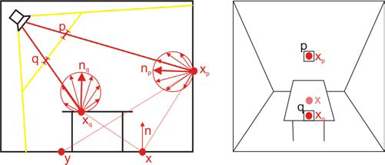
Reflective Shadow Maps III
Two indirect pixel lights corresponding to two RSM pixels

Slide 15
Our Approach
Our goal is to improve upon the RSM
A typical modern graphics card can achieve interactive framerates with up to 500 VPLs
We provide an alternative way of reducing the number of RSM VPLs without loss of radiance
Allow at least a second bounce of indirect illumination

Slide 16
First-Bounce Indirect Illumination I
The scene is rendered from the point of view of the light source
Data is stored in the RSM, as described
However, instead of flux we store radiance
Storing radiance allows tracing paths starting at first-bounce VPLs
Although RSM has a depth component, we use a higher resolution shadow map
This way we can use RSMs as small as 32x32 without compromising shadow quality

Slide 17
First-Bounce Indirect Illumination II
flux
The VPL radiance is:
Light source intensity
Pixel area
Solid angle
Angle between plane normal and rp
Aspect ratio
Vector from light source to pixel center
RSM dimensions

Slide 18
First-Bounce Indirect Illumination III
The map for a point light source.

Slide 19
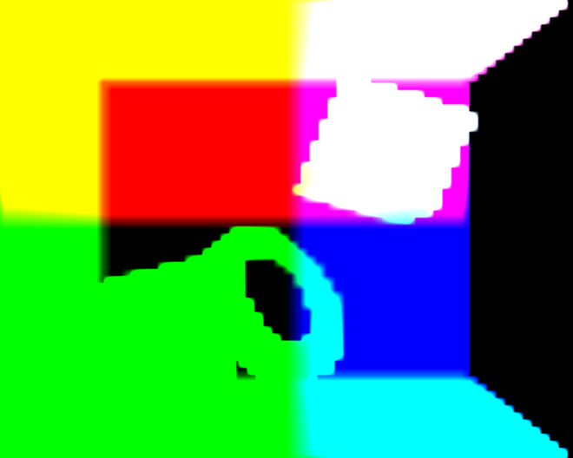
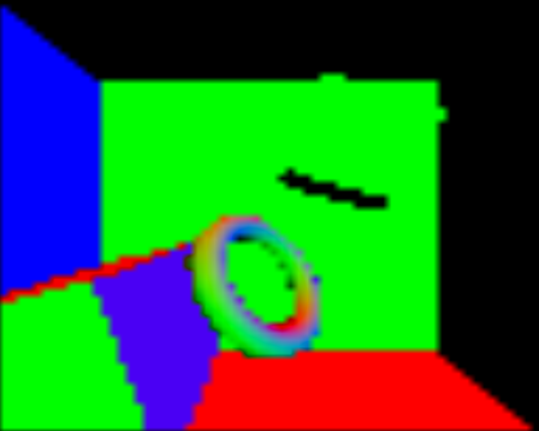
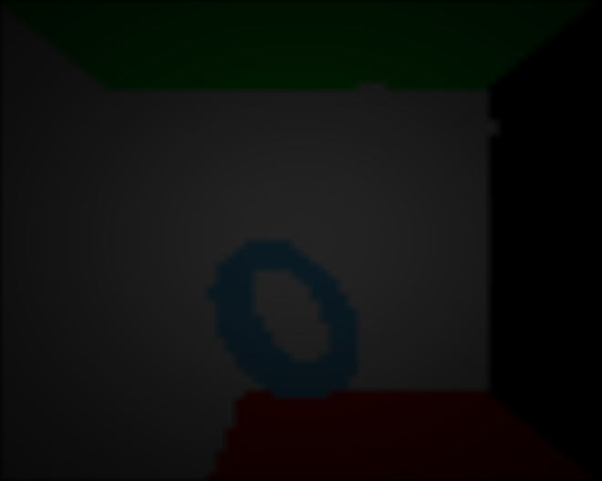
First-Bounce Indirect Illumination IV
Left to right: World coordinates, normal vectors and radiance components of a 64x64 RSM in a Cornel Box. The dimensions of the depth map are 2048x2048.

Slide 20
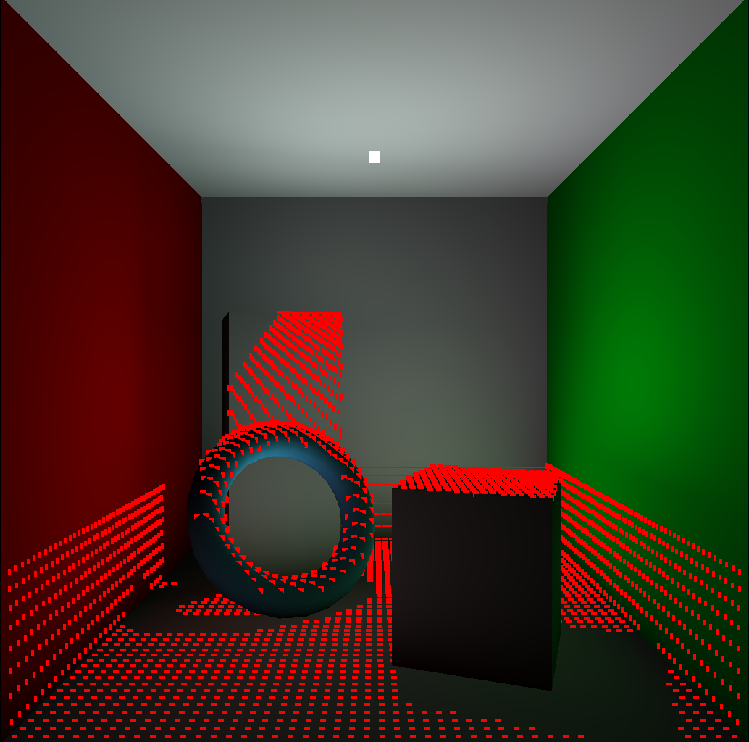
First-Bounce Indirect Illumination V
A simple Cornel Box rendered only with GI, using the previous RSM. The red dots are the VPLs (2796 in total). The light source is in the middle of the ceiling (white square), directed to the center of the floor

Slide 21
First-Bounce Aggregation I
To achieve interactive framerates the number of VPLs must be reduced
To do this without loss of radiance, we group up the VPLs
RSM provides spatial coherency
We use a custom similarity metric, inspired by irradiance caching

Slide 22
First-Bounce Aggregation II
Procedure:
The RSM is divided in progressively larger grids (i.e. 2x2, 4x4,…,64x64):
VPLs in each grid are assigned weights (through the metric) and are tested against a threshold.
Those who pass the test are grouped up.
The VPL with the greatest weight is selected as the representative of the grid.
All VPLs of this grid that pass the test are deactivated and their radiance is added to that of the representative.
Repeat 2→6 until grid cell equals grid size
Those who fail might group up when the grids expand.
The lower the threshold the more VPLs will group up.

Slide 23
First-Bounce Aggregation III
An example of the aggregation process of the RSM. Each square represents a RSM VPL. The dotted ones are those with the largest weight.

Slide 24
Similarity Metric
A weight is assigned to each VPL according to the following metric:
x: grid average VPL position
d: scene diameter
n: grid average normal vector
Ii: VPL radiance

Slide 25
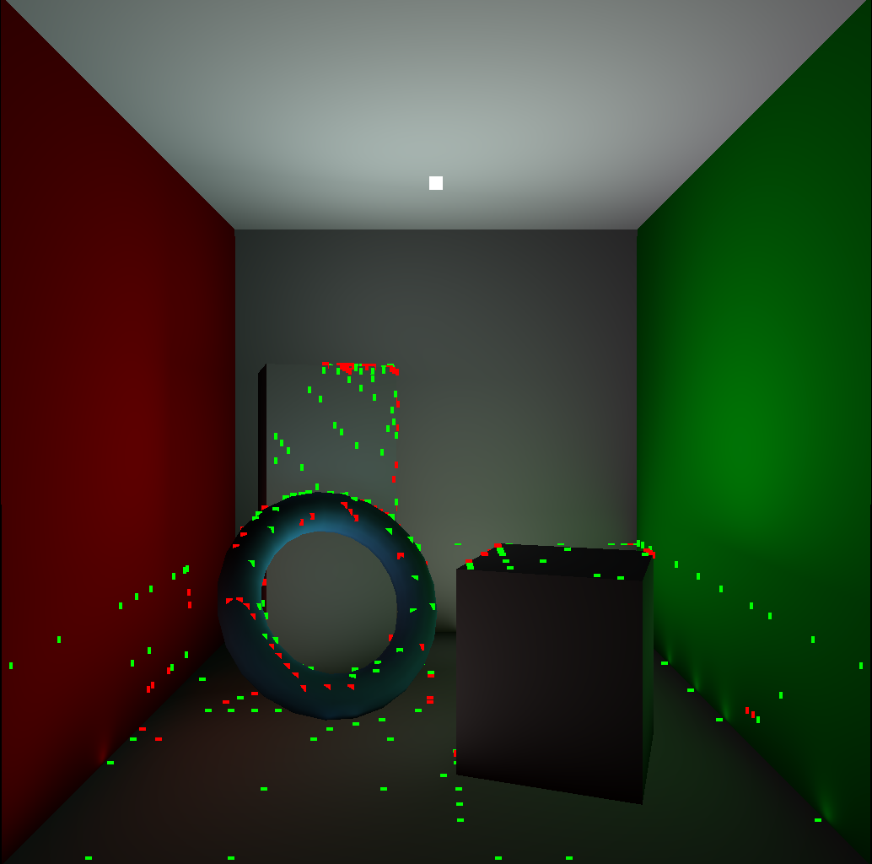
First-Bounce Aggregation Results
The same scene with the VPLs number reduced to 349. The green dots are VPLs that have resulted from aggregation. Notice that aggregated VPLs close to corners tend to cause artifacts.

Slide 26
Attenuation Factor I
VPLs that are very close to walls or objects and have resulted from aggregation tend to cause a “flashlight” effect.
To solve this problem we have introduced an attenuation factor.
In order to avoid any noticeable loss of radiance the factor is applied under certain circumstances.

Slide 27
Attenuation Factor II
When the contribution of a VPL to a surface point is calculated, the factor is applied when the following condition is met:
The distance of the VPL from the point is less than 20% of the diameter of the bounding box of the scene
Where x is the distance between the VPL and the surface point.

Slide 28
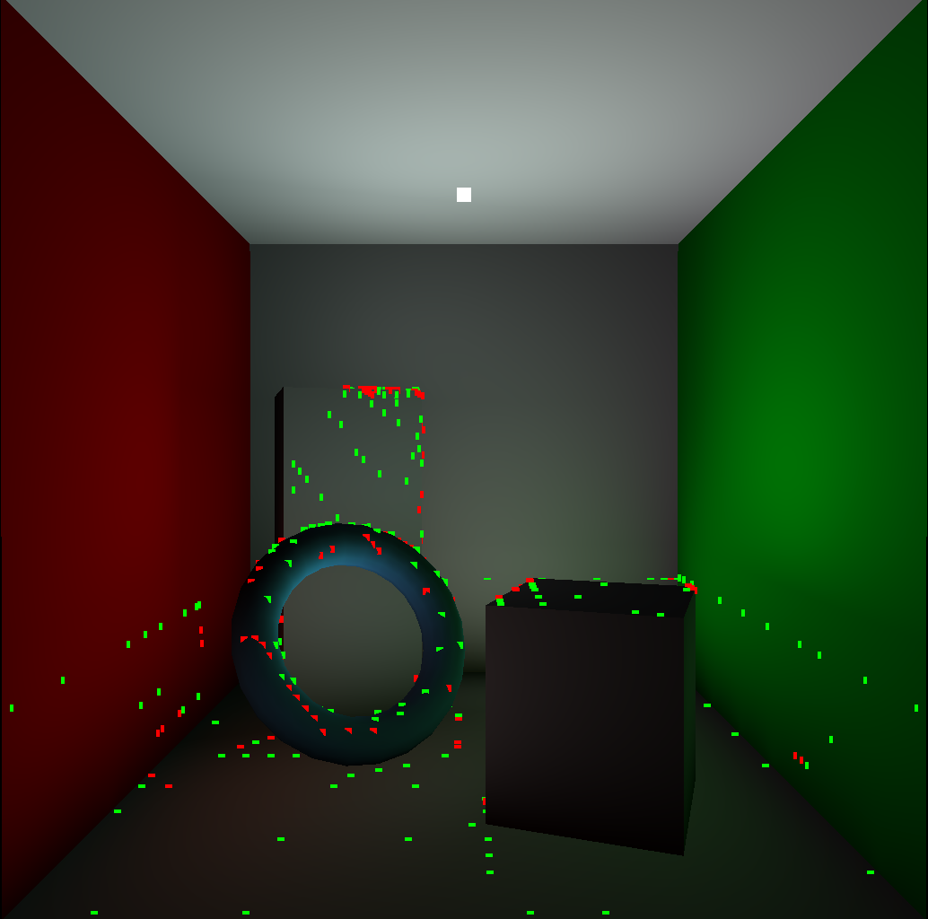
Attenuation Factor III
To solve the artifacts problem we have introduced an attenuation factor for the aggregated VPLs.

Slide 29
Additional Bounces I
RSM does not provide uniform distribution of VPLs in the whole scene, only in the field of view of the light source.
Additional bounces enhance the final result.
Secondary VPL bounces are not coherent! So:
To produce additional bounces we must trace paths up to the desired depth starting from the first-bounce VPLs that remain after the aggregation.
A grid-based clustering does not apply!

Slide 30
Additional Bounces II
Paths must be traced with interactive speed
For this we used the NVIDIA OptiX ray tracing engine.
Makes use of the parallel processing capabilities of the GPU
Each additional bounce is computed in milliseconds

Slide 31
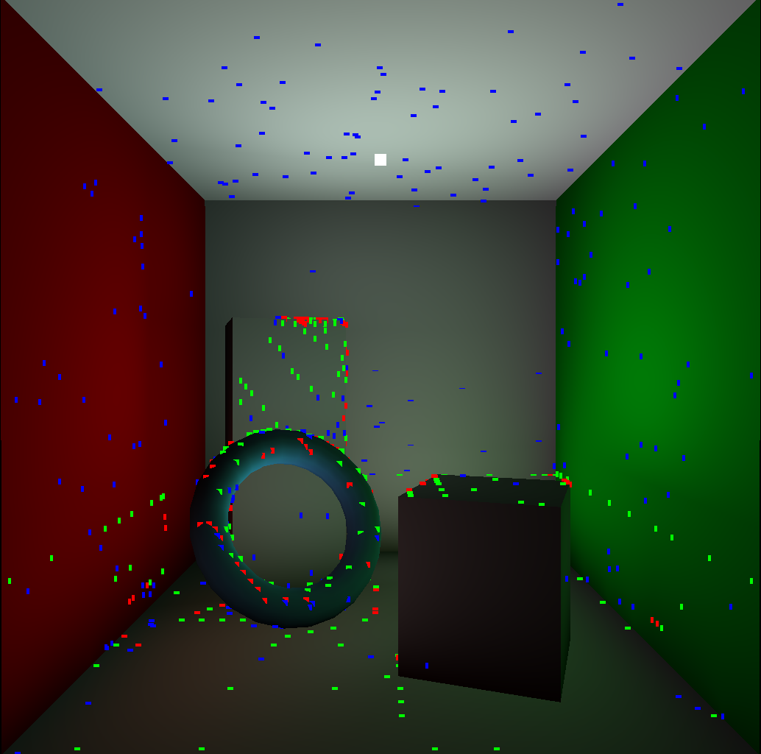
Additional Bounces III
Same scene with an additional bounce of VPLs (blue dots). There are in total 654 VPLs.

Slide 32
Aggregation of Additional Bounces I
An additional bounce can potentially double the number of the remaining VPLs.
Their number has to be reduced as well.
We achieve that through the use of a balanced Kd-tree clustering scheme:
All VPLs after the first bounce are inserted in the tree
The aggregation is done by pruning the tree at depth k
VPLs below the k level are aggregated with their ancestors on k level. These ancestors are the representatives.
VPLs above k level remain unchanged.

Slide 33
Aggregation of Additional Bounces II
Representation of the VPLs after their insertion in the Kd-tree

Slide 34
Aggregation of Additional Bounces III
k depth
An aggregation depth is selected

Slide 35
Aggregation of Additional Bounces IV
The VPLs after the aggregation. The radiance of the two last levels is added to the respective ancestor.

Slide 36
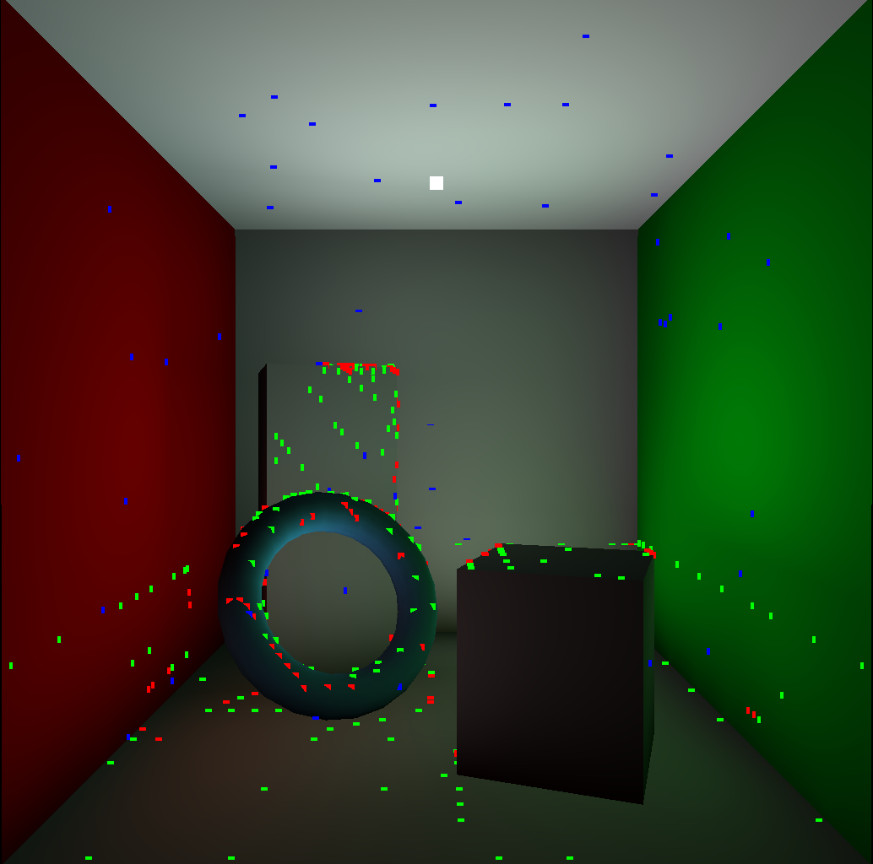
Aggregation of Additional Bounces V
The cornel box after the aggregation of the 2nd bounce. Now only 412 VPLs remain.

Slide 37
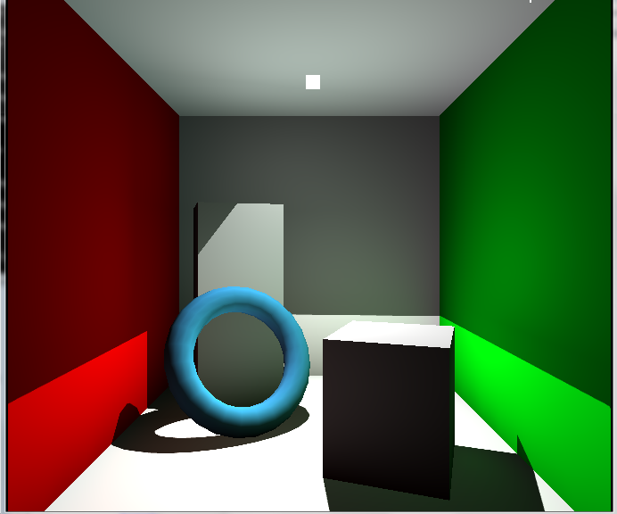
Results I
This video demonstrates our results on the cornel box, using a 32x32 RSM. The scene is rendered at about 13 FPS.

Slide 38
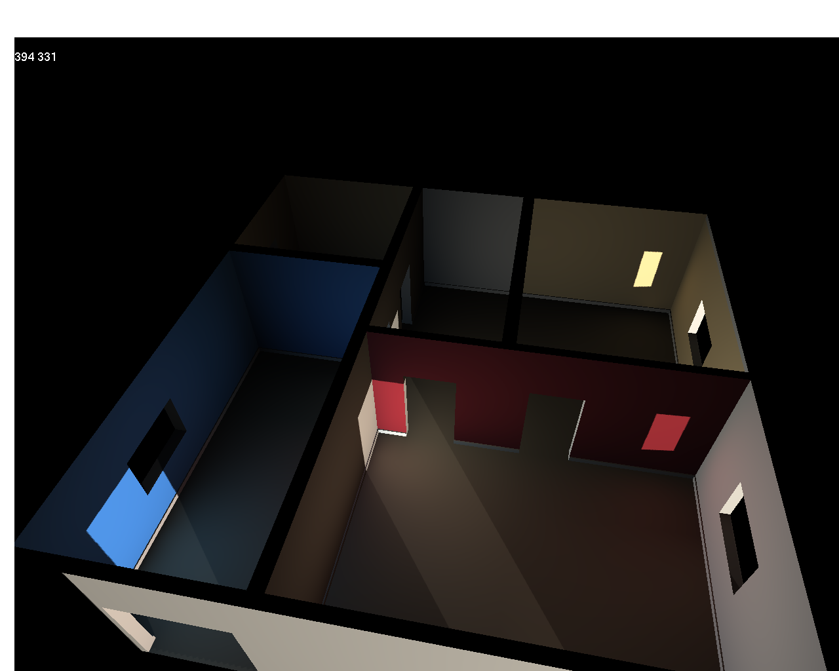
Results II
Here we have a scene with occlusion rendered using 128x128 RSM and lit by 394 VPLs. Despite the much larger size of the RSM the scene was still rendered with more than 10 fps.

Slide 39
References
[1]: KELLER, A. 1997. Instant radiosity. In Proceedings of SIGGRAPH 97, Computer Graphics Proceedings, Annual Conference Series, 49–56.
[2]: DACHSBACHER, C., AND STAMMINGER, M. 2005. Reflective Shadow Maps. In Proc. of the Symposium on Interactive 3D Graphics and Games, 203–213.

